Slide 1

Sentiment and Discount Analytics on Amazon B2C Sales: Understanding Customer Reviews and Pricing Strategies
Created by Saudeep Chattopadhyay,
Roll No: 23f1001295

Slide 2
Organization Background
Amazon is really one of the best in e-commerce that has its vast operations of buying and storing inventory. It has both B2C and B2B business.
It is a multinational e-commerce, as well as a tech corporation, with leadership in the e- commerce world
While I have focused mostly on the B2C(e-commerce) aspect of it.
The data applied in this particular project is very extensive; it exceeds 1000 different products presented on the very popular e-commerce website that is Amazon.
The dataset applies crucial elements such as product ratings, discounts, price and insightful reviews created by customers
The purpose of this project is thus to research and discover the factors controlling the performance of the products to understand which of the factors cause satisfaction among the customers who eventually lead to sales.

Slide 3
Problem Statement
To determine the impact discounts and prices have on the product ratings and reviews
By checking whether changes in ratings of a product will be analyzed to see whether the discounts actually drive higher satisfaction or whether they in fact create expectations that go unmet on occasion.
To examine the correspondence of review sentiment with product performance based on category, pricing and discounting:
By categorizing reviews and then analyzing the sentiments of those categories in relation to other parameters, one can understand how such factors affect the rating of customer satisfaction within a particular price point or product category.
Customer satisfaction is a key factor to succeed in e-commerce segment, with ratings and reviews sometimes cause changes in product visibility and influence a customer buying decision.
Despite there being ample customer feedback available, online firms frequently fail to recognize precisely what factors play the largest role in promoting the process of making positive or negative reviews.

Slide 4
Data Collection and Methodology
Data is collected from Kaggle (Secondary Dataset): (https://www.kaggle.com/datasets/karkavelrajaj/amazon-sales-dataset/data)
Used Kaggle dataset (1,000+ products) to determine if pricing/discount strategies affect customer sentiment and ratings.
Tools Used: -
Google Collab (Platform for data cleaning, data visualization, modeling): (https://colab.research.google.com/drive/195MNvwmcC6nzXIw7PulTP8aA0I5WyaXI?usp=sharing)
Python Libraries: Pandas(data manipulation and analysis), NumPy(numerical operations), Matplotlib(Visualization library), Seaborn(Visualization library), Scikit-learn(for linear regression), Natural Language Toolkit or NLTK (for valence aware dictionary and sentiment reasoner or VADER tool - used for sentiment analysis)

Slide 5
Data Collection and Methodology (Continued)
At first, for data cleaning was done the inside google collab, numpy and pandas library were used by taking kaggle data of amazon as input as excel file where missing values were handled, duplicates were removed and data types were converted
Then for sentiment analysis, VADER tool from NLTK library was used to classify reviews as positive negative or neutral based on compound score
Then Exploratory Data Analysis was done using numpy and pandas where patterns and relationships were found out for price, discount, ratings and sentiments
After that feature engineering was done and variables like discount_category and review_length were created
After that, linear regression modeling was done in order to find mean squared error(MSE) and score to assess relationship between price, discount and ratings
Meanwhile, using seaborn and matplotlib library(pyplot tool), visualizations and necessary graphs were generated like bar charts, boxplot, scatter plot in between and also in the end
Finally, the cleaned and analysed data with sentiment of reviews as generated as excel file in collab

Slide 6
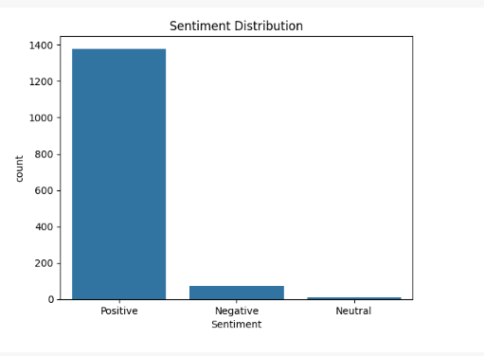
Results and Findings
Figure 1 shows that the majority of customer reviews are categorized as Positive, with over 1,300 instances. Negative and Neutral sentiments make up a much smaller portion, together contributing less than 10% of total reviews
This means that a significant majority of customer reviews fall into the positive category. This implies that overall, customers are generally satisfied with their purchases on Amazon.
Figure 1

Slide 7
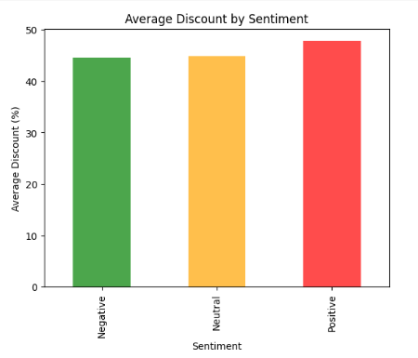
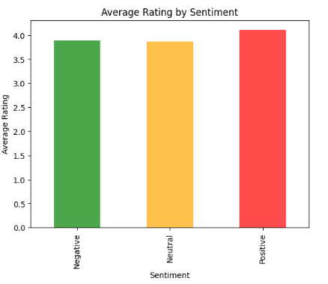
Results and Findings (Continued)
In Figure 2, Products with Positive sentiment had slightly higher average discounts (~48%) than Neutral or Negative sentiments (~44-45%). The difference, while minor, suggests that customers may appreciate higher value perception through discounts.
Figure 2, shows that products associated with positive sentiment also enjoy slightly higher discounts on average.
In Figure 3, The average rating for Positive reviews is above 4.1, compared to 3.9 for Neutral and 3.85 for Negative. Although not a dramatic difference, it shows a consistent gradient of increasing satisfaction from Negative to Neutral to Positive
Figure 3 highlights a subtle but consistent upward trend in average rating from negative to positive sentiment
Figure 2
Figure 3

Slide 8
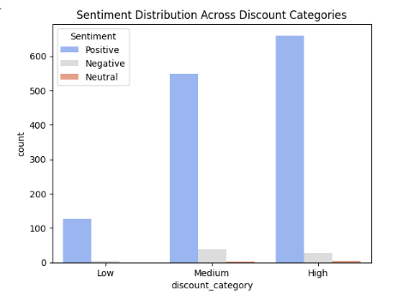
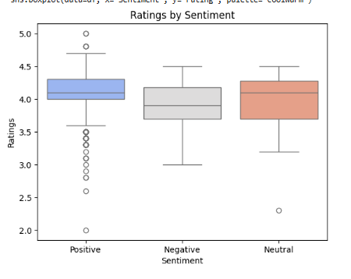
Results and Findings (continued)
In Figure 4, the High discount category shows the highest volume of Positive reviews, followed by Medium, and lastly Low discount. Negative sentiments are slightly more frequent in lower discount ranges.
Figure 4 demonstrates a direct correlation between higher discount percentages and increased positive sentiment. High-discount products have notably more positive reviews compared to medium and low-discount counterparts.
In Figure 5, The boxplot illustrates that Positive reviews tend to have higher and more consistent rating scores (median ≈ 4.2). Negative reviews are more dispersed and lower in rating, with many falling between 2.0 and 3.5.
Figure 5 shows that higher ratings accompany positive sentiments, while negative sentiments are associated with lower and more dispersed ratings.
Figure 4
Figure 5

Slide 9
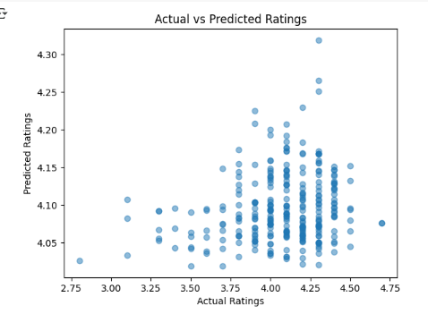
Results and Findings (continued)
The plot in Figure 6 demonstrates a weak correlation between actual and predicted ratings. Most predictions fall within a narrow band (~4.05–4.20), regardless of the actual rating, indicating a poor model fit (R² ≈ 0.03)
The scatter plot clearly shows that predictions made by the linear regression model are poorly aligned with actual ratings. The extremely low R² score (~0.03) confirms that the selected independent variables price and discount percentage have almost no predictive power in isolation
Figure 6

Slide 10
Interpretation and Recommendations
Interpretations
Most reviews positive, regardless of discount (However, possibility of review bias customers who are highly satisfied are generally more motivated to leave feedback is there)
High Discounts Improve Perception(positive sentiments) but does not lead to high Ratings. Ratings are likely driven by other factors such as product quality, usability, packaging, and delivery experience
Weak Predictive Power of Price and Discount shows pricing alone does not significantly influence customer satisfaction
Sentiment is a Better Signal than Star Ratings as users provided high ratings but included complaints or dissatisfaction in their review text
Recommendations
Sellers should utilize the most emotionally rich and positive reviews as promotional material
Monitoring sentiment trends over time provides a valuable early warning system for product issues
Sellers should integrate sentiment analysis into their evaluation processes instead of only relying on ratings. These dashboards should highlight changes in sentiment polarity, flag categories with increasing negative feedback, and provide alerts when sentiment trends diverge from rating trends.
It is advisable for sellers to develop dashboards that track sentiment data over time.
Shift the focus from price based to value based selling. Sellers must communicate the reason or value behind the price since customers are not only looking for low prices but also value and utility in their purchases.

Slide 11
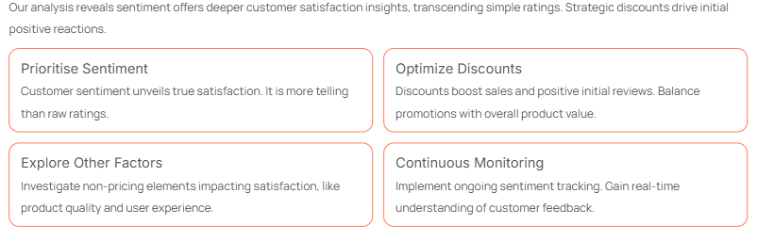
Conclusion

